Slide 1
Data Workshop
Measuring Institutions

Slide 2
Outline
Institutions and Productivity
Measuring Institutions
Economic Freedom Index
Components
Level of Analysis
Data
Managing Panel Data
Finding
Cleaning
Analyzing

Slide 3
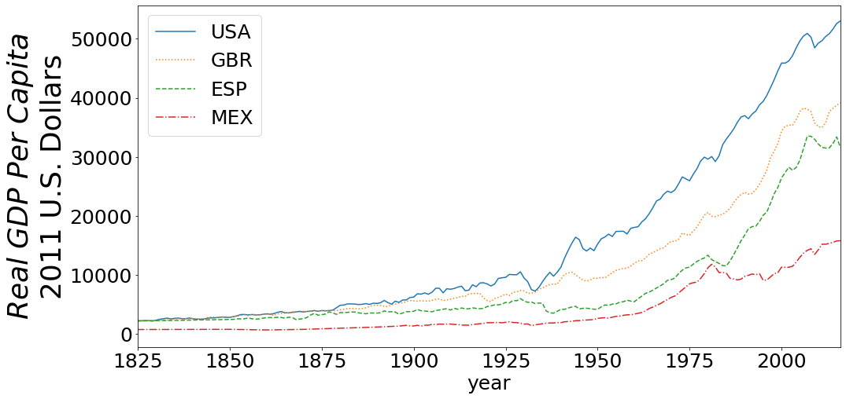

Slide 4
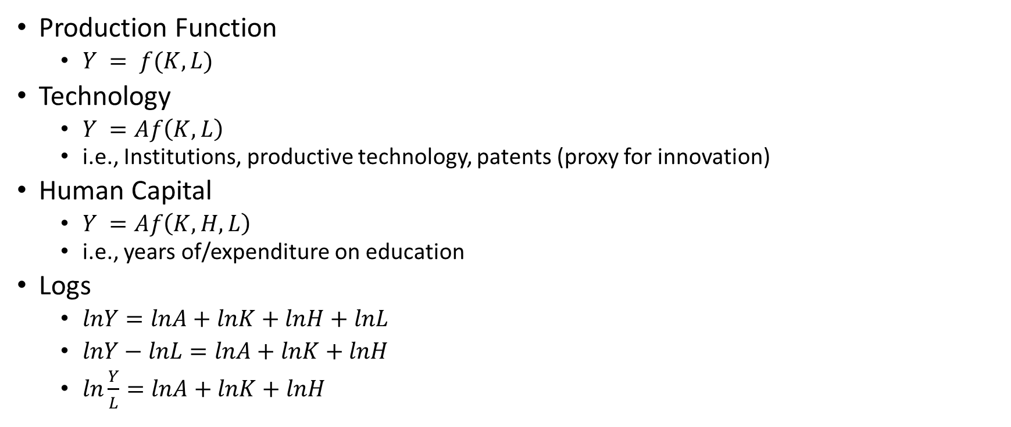
Institutions and Production Function
Production Function
$Y = f(K,L)$
Technology
$Y =Af\left(K,L\right)$
i.e., Institutions, productive technology, patents (proxy for innovation)
Human Capital
$Y =Af\left(K,H, L\right)$
i.e., years of/expenditure on education
Logs
$lnY=lnA+lnK+lnH+lnL$
$lnY−lnL=lnA+lnK+lnH$
$ln\frac{Y}{L}=lnA+lnK+lnH$

Slide 5
Institutions
As Technology
Rules of the Game
Rule of law
Alienable Property Rights
Human (Social) Capital
Shared knowledge/procedures/values/morals
At the end of the day, good institutions lower transactions costs (costs of doing business)

Slide 6
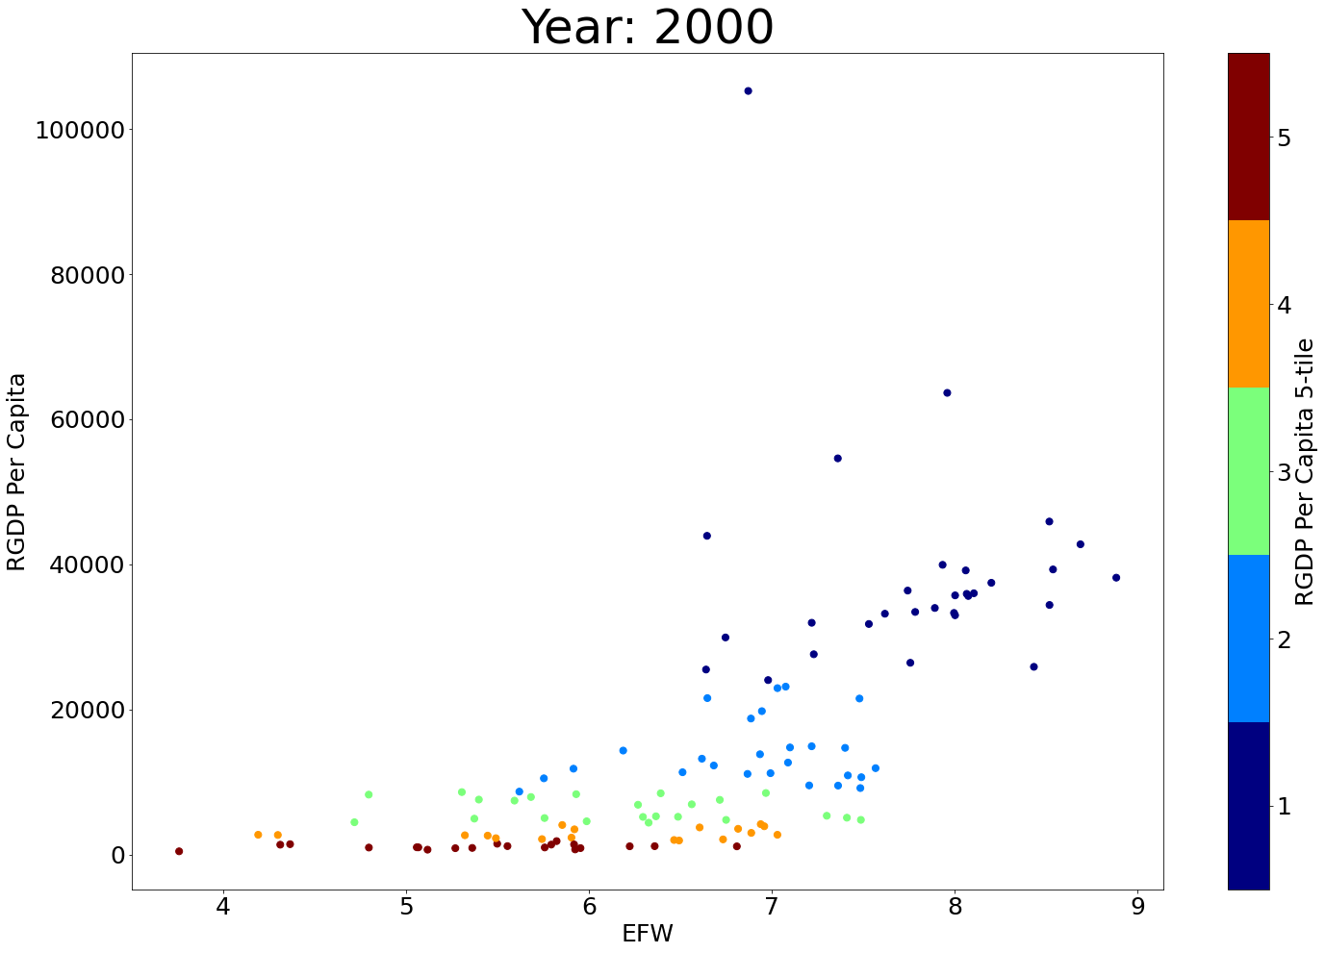
Economic Freedom Index

Slide 7
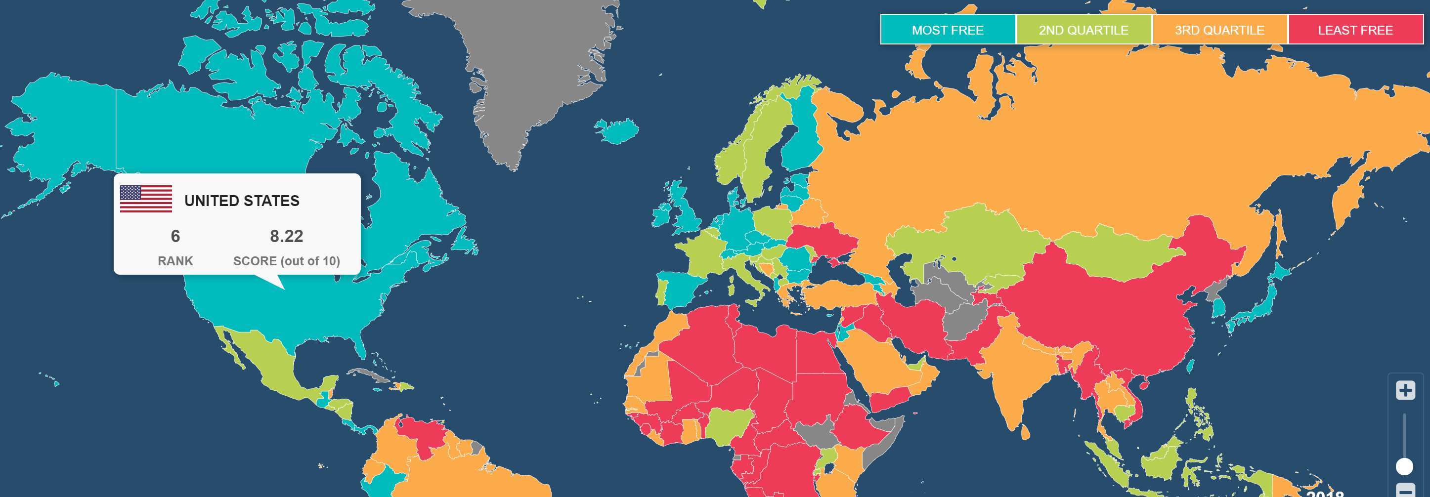
Size of Government
Legal Systems and Property Rights
Sound Money
Freedom to Trade Internationally,
Regulation

Slide 8
Size of Government
A. Government consumption
B. Transfers and subsidies
C. Government enterprises and investment
D. Top marginal tax rate
(i) Top marginal income tax rate
(ii) Top marginal income and payroll tax rate
E. State ownership of assets

Slide 9
Legal System and Property Rights
A. Judicial independence
B. Impartial courts
C. Protection of property rights
D. Military interference in rule of law and politics
E. Integrity of the legal system
F. Legal enforcement of contracts
G. Regulatory costs of the sale of real property
H. Reliability of police
I. Business costs of crime
J. Gender Disparity Adjustment

Slide 10
Sound Money
A. Money growth
B. Standard deviation of inflation
C. Inflation: most recent year
D. Freedom to own foreign currency bank accounts

Slide 11
Freedom to Trade Internationally
A. Tariffs
(i) Revenue from trade taxes (% of trade sector)
(ii) Mean tariff rate
(iii) Standard deviation of tariff rates
B. Regulatory trade barriers
(i) Non-tariff trade barriers
(ii) Compliance costs of importing and exporting
C. Black-market exchange rates
D. Controls of the movement of capital and people
(i) Foreign ownership / investment restrictions
(ii) Capital controls
(iii) Freedom of foreigners to visit

Slide 12
Regulation
A. Credit market regulations
(i) Ownership of banks
(ii) Private sector credit
(iii) Interest rate controls / negative real interest rates
B. Labor market regulations
(i) Hiring regulations and minimum wage
(ii) Hiring and firing regulations
(iii) Centralized collective bargaining
(iv) Hours regulations
(v) Mandated cost of worker dismissal
(vi) Conscription
C. Business regulations
(i) Administrative requirements
(ii) Bureaucracy costs
(iii) Starting a business
(iv) Extra payments / bribes / favoritism
(v) Licensing restrictions
(vi) Cost of tax compliance

Slide 13
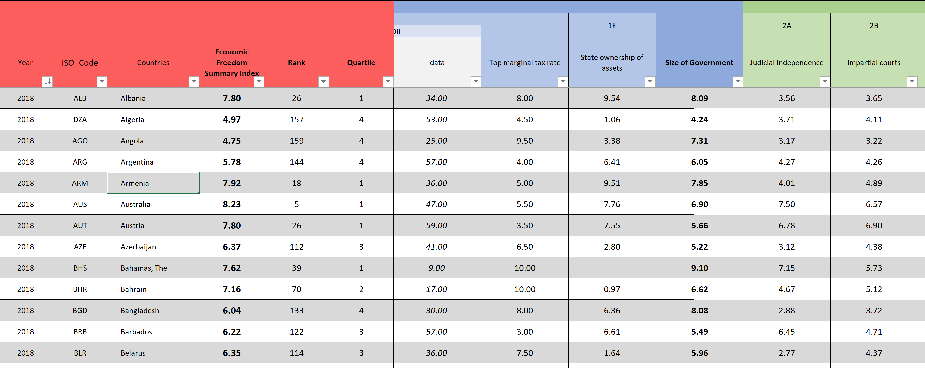

Slide 14
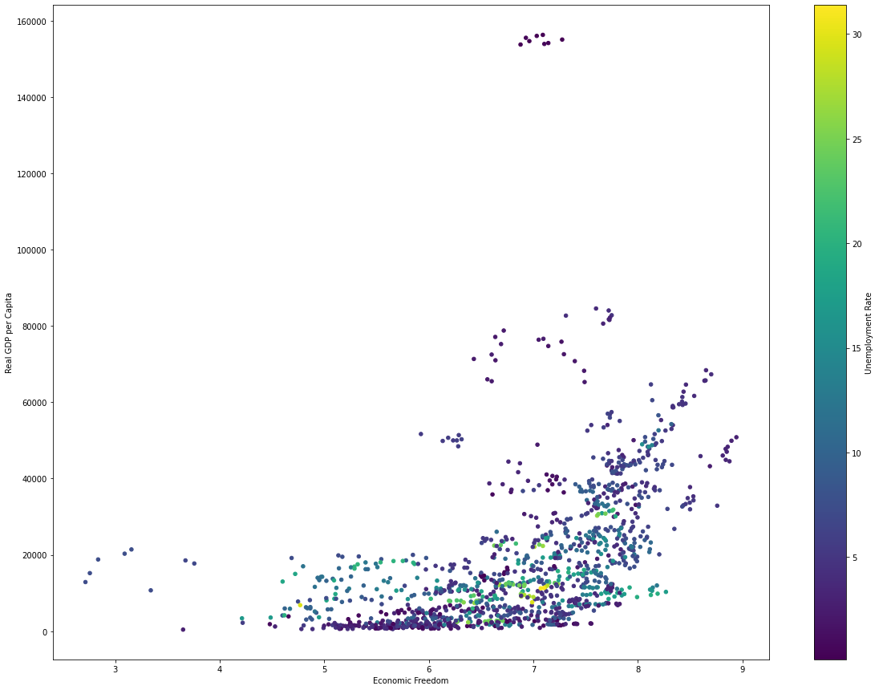

Slide 15
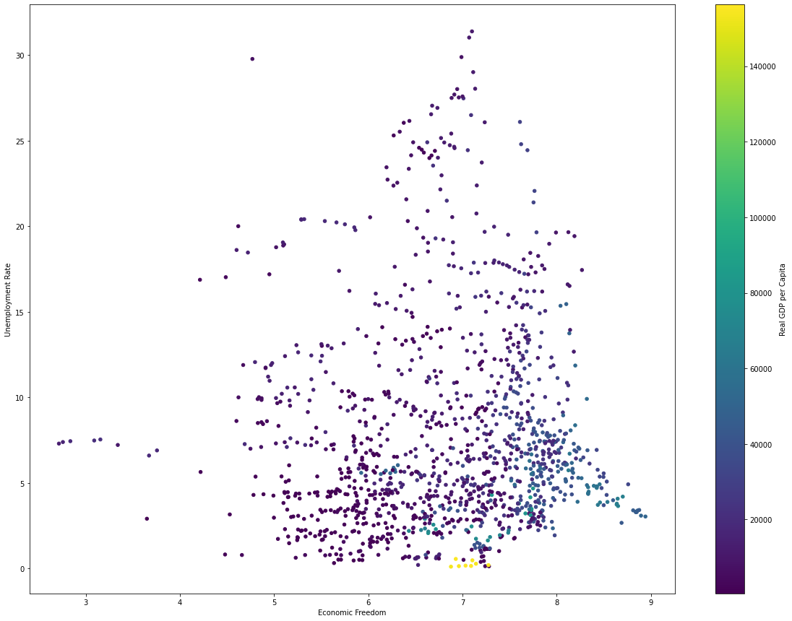

Slide 16
Economic Freedom of United States / North America
Economic Freedom in U.S. / North America
Freedom in the 50 States (Cato)
Economic Freedom of North America (Fraser)
Entrepreneurship
Kauffman Index
https://indicators.kauffman.org/wp-content/uploads/sites/2/2021/04/Kauffman_Indicators_New_Employer_Business_Data_April_2021.csv
Project Idea: Compare explanatory power of Freedom in the 50 States to Economic Freedom of North America for Kauffman Index.

Slide 17
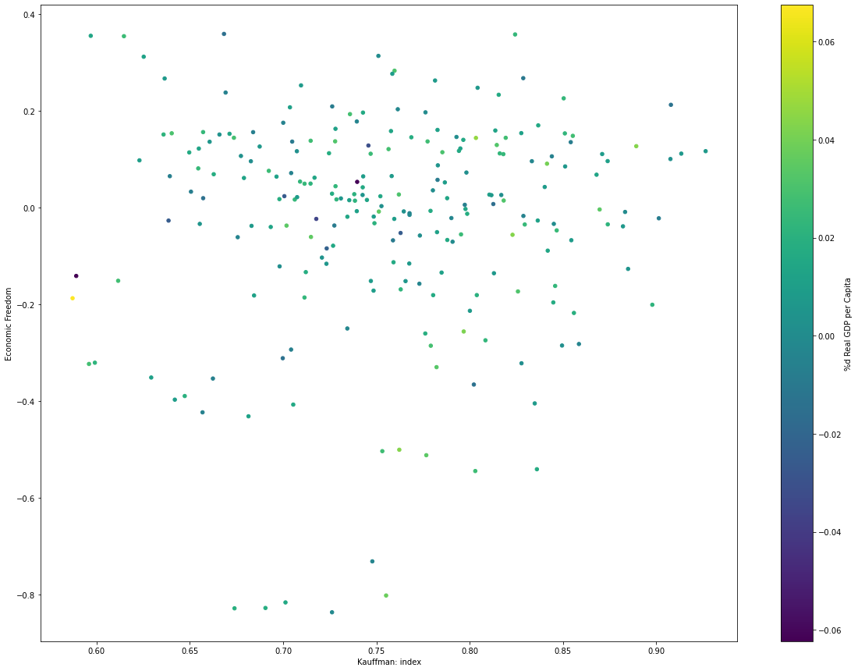

Slide 18
Data
Panel Data
Use multiindex:
Usual Geographic Entity, Year
Finding
All necessary data will not typically be available from a single source
Cleaning
Data indices must be matched
Null values accommodated
Data types matched
Analyzing
Visualization
Be creative, don’t waste any opportunity to clearly present and reinforce dimension
Statistics
Difference in Means, OLS, Panel Regression
Look for economic and statistical significance
Visualizations and statistics are complements, not substitutes!

Slide 19

Python
Make sure you have installed Anaconda and included it in the system path
Single tool for
Data scraping
Data management
Data visualization
Statistical Analysis
Report writing!
Easy to share with collaborators!

Slide 20
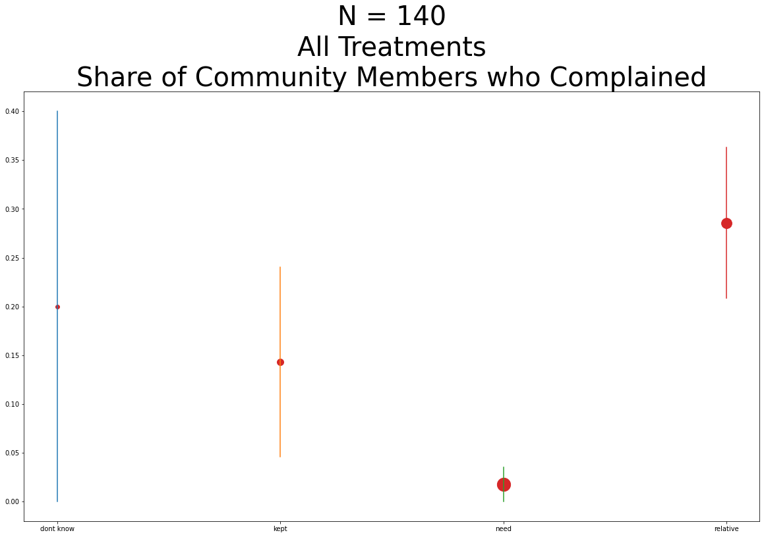
Get to work!

